Slide 1

Group 1 – Water FCA Analysis
Alm Robert
Imeri Lavdim
Singh Vipin

Slide 2

Our Vision
Our vision is to offer a cheap, automatic, safe, and ongoing improved method of analysing water, using flow cytometry, producing in that way an output that can be used to draw useful conclusions about the safeness or the purity of the water and if it is possible to be used for further research, (other methods of analysis).

Slide 3

Water Safety Problem
Water is important for sanitation, agriculture, and most importantly hydration.
SDG 6: "Ensure availability and sustainable management of water and sanitation for all“.
In 2017, 2 billion people worldwide lacked access to basic sanitation.
A primary cause of child mortality is contaminated water and poor sanitation.

Slide 4

Our solution
We can feed the data from flow cytometry analysis to Machine learning algorithm, to generate a model that can detect if the water is contaminated or not.
Our part on this solution can be the part of collecting and pre-processing the data.
Reaching a successful ML/AI model to complete the solution is still possible, but it can be done by others, by using our tool to collect and process the data.

Slide 5
Challenges
Not enough data is collected.
The collected data is unorganized or poorly labelled.
No other indicator apart the FCA results.
Extreme workload with limited time.
Lack of expertise in several areas.

Slide 6
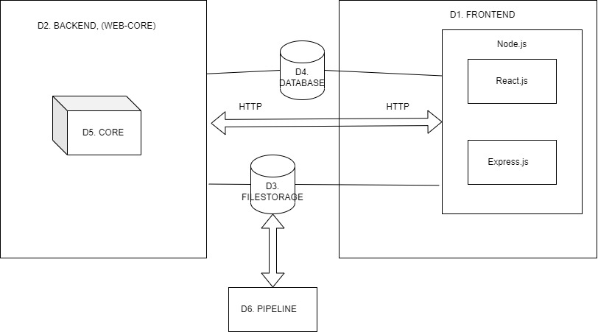
Design
Frontend
Backend
Database
File Storage
Core
Pipeline

Slide 7
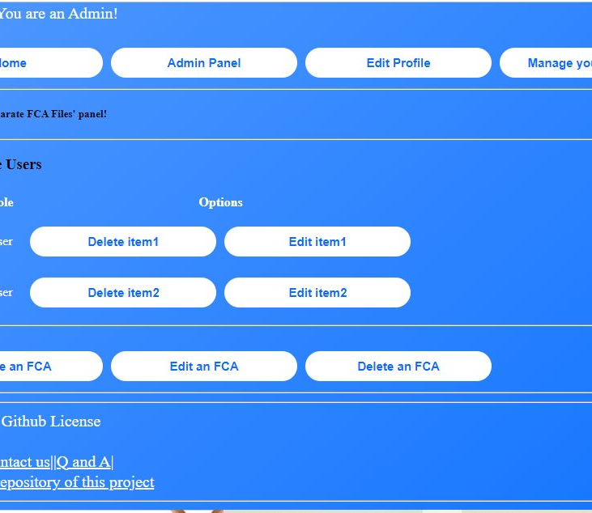
Front End and Wed Services
A MERN instance that uses React.js as its front end.
The express.js handles communication with the other components.
Intuitive GUI.
Recursive CRUD architecture that allows the system to be as advanced as possible.

Slide 8

Core
The heavy computational tasks are happening here.
Mostly the data pre-processing and hopefully a bit ML analysis.
Few actions are taken on demand.
Other actions are meant to be happen automatically.
Pipeline helps with the preparation of the data.

Slide 9
Design Concepts
Web platform available for everyone to use.
Core module that allows the use of the engine from other platforms.
Modularity and reusability are important.

Slide 10
Conclusion
It can be done.
It needs time and cooperation.
The important part is the modularity of each component.

Slide 11

Thank you for your time!

